Slide 1
ACME Corp Virtual Environment
John Doe, System Administrator, ACME Corp
25 May, 2011
Notes:
IT is once again facing a time of change. Fortunately, there is a safe path to this new approach, one that transforms IT into an agile service provider. VMware, the market leader in virtualization and cloud infrastructure, is working in partnership with IT organizations throughout the world to accelerate this transition.

Slide 2
Agenda
About Us
Business Problem
Technical Solution
Lessons Learned
Future Plans
Questions

Slide 3
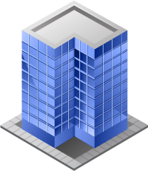
About Us
ACME Corp makes widgets
You might know them
Or maybe not
Enterprise corporation in Australia
10000 employees
871 servers
13 offices around the country
Brisbane
Sydney
Melbourne
Perth
Hobart

Slide 4
Business Problem
What were we trying to fix?
Most CFOs would not support a VMware project with a financial justification
Datacenter space
Running out of power in the datacenter
Business Agility
Needed to be able to provision new IT services quickly to meet changing market demands
Cool Factor
The other guys were doing it
This would be an example of one of those other CFOs ☺

Slide 5
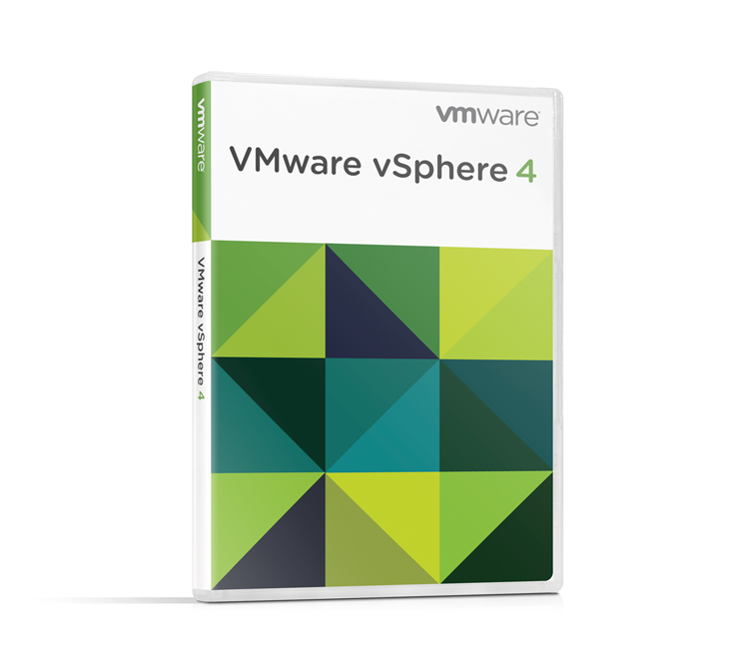
Technical Solution
New blade servers
<vendorA> blades
Saved $50K in physical cabling costs
144GB RAM per blade
vSphere clusters
VMware ESXi Hypervisor
30:1 consolidation ratio
8 nodes in a cluster,
spread across 2 blade chassis (4 each for HA primary)
iSCSI storage
Old SAN fabric was broken
Ethernet everywhere is a bonus

Slide 6
Technical Solution (2)
Logical Design
Resource Pool
VMware ESX
VMware ESX
VMware ESXi
Physical Servers

Slide 7
Lessons Learned
What worked
vSphere installation and configuration is simple
Cost savings are real
What didn’t
Business processes still need work
Where they lied
It doesn’t make me coffee in the morning
Why I have my weekends back
The servers keep working
I don’t need to come in on weekends for (most) maintenance

Slide 8
Future Plans
VMware vCloud Director
Buying VMware stock options
Getting Michael Francis to have a drink with us ☺

Slide 9
VMware vCloud Director
Organization 1
Organization m
Users
IT
VMware vCloud Director
User Portals
Catalogs
Security
Public Clouds
VMware vCloud API
Virtual Datacenter 1 (Gold)
VMware vShield
Virtual Datacenter n (Silver)
Programmatic
Control and
Integrations
VMware
vCenter Server
VMware
vCenter Server
VMware
vCenter Server
VMware vSphere
VMware vSphere
VMware vSphere
Secure Private Cloud
Notes:
All icons separated out.

Slide 10
Questions?

Slide 11
Color Palette
Virtualization Layer
Hardware Layer
R: 0
G: 149
B: 211
R: 77
G: 77
B: 77
Virtualization Layer
Virtual Machine
R: 137
G: 203
B: 223
R: 192
G: 192
B: 192
Operating System
Applications
R: 0
G: 61
B: 121
R: 248
G: 152
B: 29
Management Layer
Applications
R: 109
G: 179
B: 63
R: 217
G: 84
B: 30

Slide 12
3D shapes

Slide 13
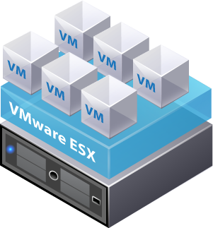
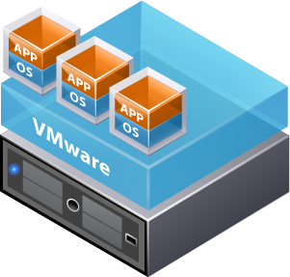
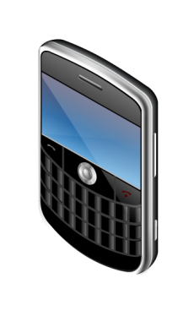
Icon and Diagram Library
Download the full VMware Icon & Diagram PPT library: http://communities.vmware.com/docs/DOC-13702

